Slide 1

Environment Setup

Slide 2
Agenda
Python Installation
Overview
Windows/Mac Installation
Anaconda Installation
Create Environment
Installing Necessary Dependencies
Python IDE’s
Jupyter Notebook
ML Studio
Google Colab
Spyder

Slide 3
Python Overview
Python is Interpreted − Python is processed at runtime by the interpreter. You do not need to compile your program before executing it. This is similar to PERL and PHP.
Python is Interactive − You can actually sit at a Python prompt and interact with the interpreter directly to write your programs.
Python is Object-Oriented − Python supports Object-Oriented style or technique of programming that encapsulates code within objects.
Python is a Beginner's Language − Python is a great language for the beginner-level programmers and supports the development of a wide range of applications from simple text processing to WWW browsers to games.

Slide 4
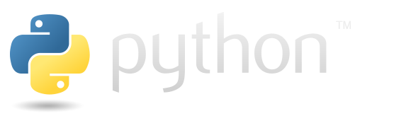
Python Installation
Windows: https://www.python.org/downloads/windows/
Mac : https://www.python.org/downloads/mac-osx/
Linux/Unix: https://www.python.org/downloads/source/
ML Studio
Link: https://mlstudio.sapai.c.eu-de-1.cloud.sap:30001

Slide 5
Anaconda
Website: https://www.anaconda.com/
Download:
Windows: https://repo.anaconda.com/archive/Anaconda3-2019.03-Windows-x86_64.exe
Mac: https://repo.anaconda.com/archive/Anaconda3-2019.03-MacOSX-x86_64.pkg
Linux: https://repo.anaconda.com/archive/Anaconda3-2019.03-Linux-x86_64.sh
Creating Environment and Installing useful libs:
conda create –n tks python=3.6
activate tks
conda install numpy scikit-learn matplotlib pandas jupyter notebook

Slide 6
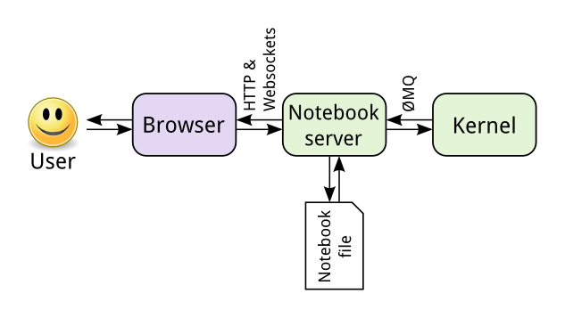
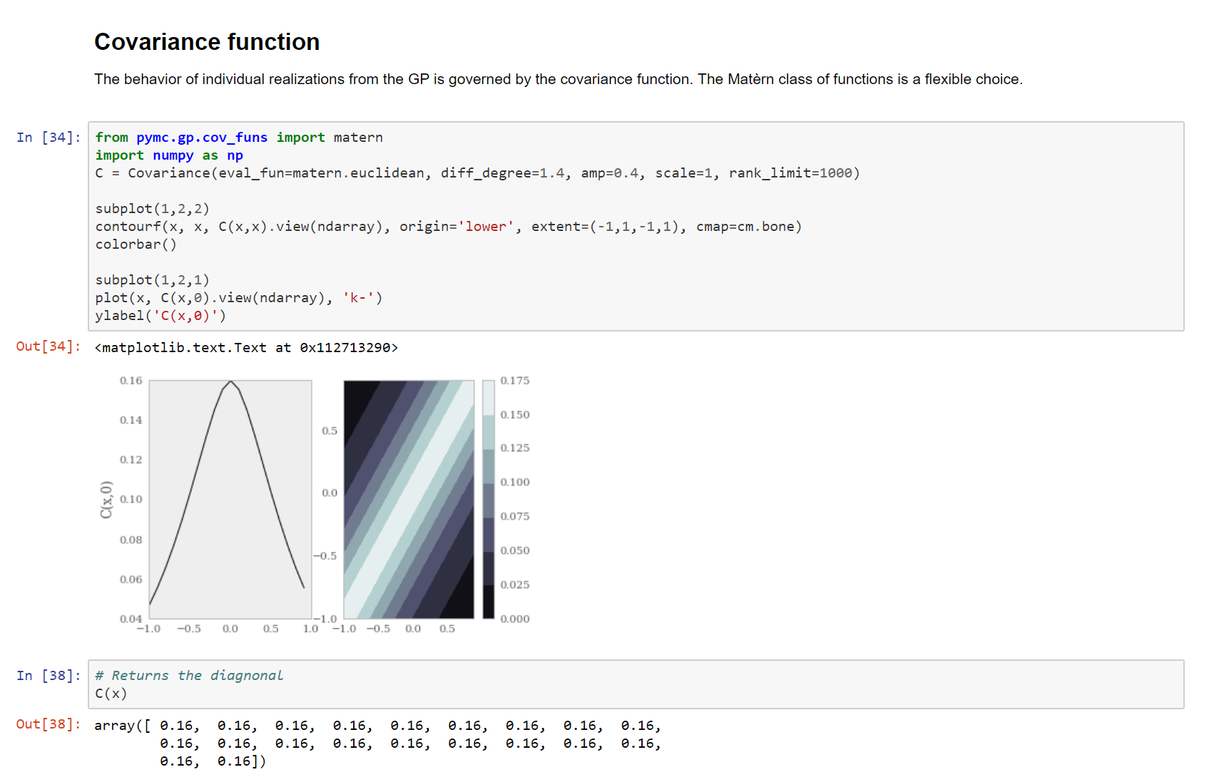
Jupyter Notebook
Install: python3 -m pip install jupyter
Note: Advised to use the jupyter notebook from the anaconda environment which is installed in previous step

Slide 7
Thank you.

